Slide 1

Ch.07 Error and Exception Handling
Siva R Jasthi
ICS325 – Unrestrictedet Application Development
Information and Computer Sciences
Metropolitan State University

Slide 2
Objectives
Exception handling concepts
Exception control structure try – throw – catch
The Exception class
User-defined Exceptions

Slide 3
Basic Use of Exceptions
When an exception is thrown, the code following it will not be executed, and PHP will try to find the matching "catch" block.
If an exception is not caught, a fatal error will be issued with an "Uncaught Exception" message.

Slide 4
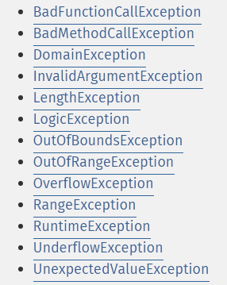
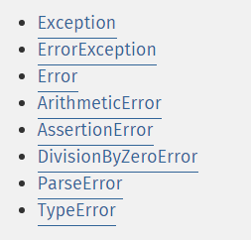
Standard Set of Exceptions in SPL
Standard Set of Exceptions in SPL
Predefined Exceptions

Slide 5
Try, throw and catch
To avoid the error from the example above, we need to create the proper code to handle an exception.
Proper exception code should include:
Try - A function using an exception should be in a "try" block. If the exception does not trigger, the code will continue as normal. However if the exception triggers, an exception is "thrown"
Throw - This is how you trigger an exception. Each "throw" must have at least one "catch"
Catch - A "catch" block retrieves an exception and creates an object containing the exception information

Slide 6
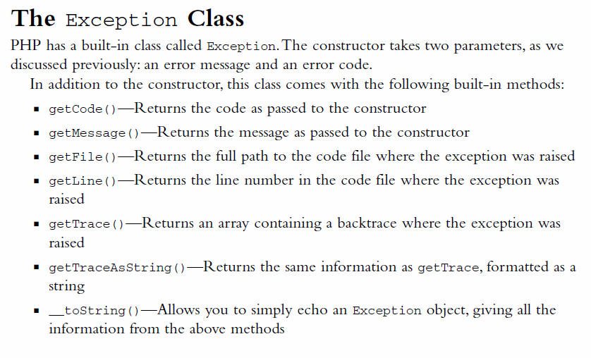
Exception Class

Slide 7
Custom Exception class
Creating a custom exception handler is quite simple. We simply create a special class with functions that can be called when an exception occurs in PHP. The class must be an extension of the exception class.
The custom exception class inherits the properties from PHP's exception class and you can add custom functions to it.
<?php class customException extends Exception { public function errorMessage() { //error message $errorMsg = 'Error on line '.$this->getLine().' in '.$this->getFile() .': <b>'.$this->getMessage().'</b> is not a valid E-Mail address'; return $errorMsg; } } $email = "someone@example...com"; try { //check if if(filter_var($email, FILTER_VALIDATE_EMAIL) === FALSE) { //throw exception if email is not valid throw new customException($email); } } catch (customException $e) { //display custom message echo $e->errorMessage(); } ?>

Slide 8
Multiple Exceptions
<?php class Exception1 extends Exception { public function errorMessage() { // …
} }
class Exception1 extends Exception { public function errorMessage() { // …
} }
$file_name= “input_file.txt"; try { // read the file } catch (Exception1 $e) { //display custom message echo $e->errorMessage(); }
catch (Exception2 $e) { //display custom message echo $e->errorMessage(); } ?>
Something can go wrong in multiple ways
Example: Reading a file
File is not there
It is wrong format
Do not have permissions to read the file
It is possible for a script to use multiple exceptions to check for multiple conditions.:

Slide 9
Top Level Exception Handler
<?php
function myException($exception) {
echo "<b>Exception:</b> " . $exception->getMessage();
}
// setting the top level exception handler
set_exception_handler('myException');
//create function with an exception
function checkNum1($number) {
if($number<0) {
throw new Exception("checkNum1: Value must be a +ve");
}
return true;
}
// call the function without catch
checkNum1(-1);
//create function with an exception
function checkNum2($number) {
if($number>0) {
throw new Exception("checkNum2: Value must be -ve");
}
return true;
}
// call the function without catch
checkNum2(1);
?>
One way to get around the "every throw must have a catch" rule is to set a top level exception handler to handle errors that slip through.
May be useful in doing quick prototyping (not recommended for production code).
If something goes wrong, the message is thrown and the execution stops.
However, if you use proper try – catch blocks, you can recover from the messages and decide to proceed further

Slide 10
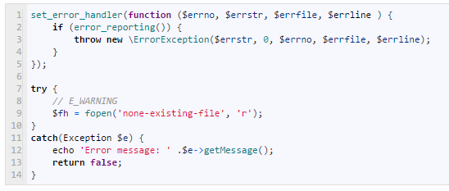
Errors and Exceptions
Standard error handling is the older way of handling errors in PHP. Exception handling is only available from PHP 5 onward and requires using an object-oriented programming structure.
Both can be used alongside each other. In fact, any exception that is thrown but not caught will eventually generate an E_FATAL error with the message “Uncaught Exception.”
With the set_error_handler() function code below, we could even handle all standard errors as an exception:

Slide 11
Difference between Java and PHP
There is no “throws” construct in PHP. (In java, the method signature can contain “throws”)
In PHP, methods simply “throw” the exceptions.
Rest of the concepts are similar (throw, try, catch, finally)

Slide 12
Summary
Simple Rule: If you throw something, you have to catch it
Code may be surrounded in a try block, to help catch potential exceptions
Each try block or "throw" must have at least one corresponding catch block
Multiple catch blocks can be used to catch different classes of exceptions
Exceptions can be thrown (or re-thrown) in a catch block within a try block
You can create your own exceptions by extending the PHP Extension class.

Slide 13
References
PHP Manual http://php.net/manual/en/language.exceptions.php
W3 Schools
http://www.w3schools.com/php/php_exception.asp
Error Handling in PHP
http://www.hostingadvice.com/how-to/php-show-errors/

